Slide 1

Introduction to Operating Systems CS/COE 1550
Fall 2021
Sherif Khattab
ksm73@pitt.edu
(Some slides are from Silberschatz, Galvin and Gagne ©2013)

Slide 2
Announcements
Homework 1 will be posted this Friday
Recitations start this week
Tophat questions assigned as homework

Slide 3
Last lecture …
System call invocation is very expensive!
Don’t make unnecessary syscalls in your applications.
2
7
6
12
10
1
3
5
4
11
8
9

Slide 4
Muddiest points
Steps of syscall vs hardware interrupt
How the CPU knows where to look in the IDT table (in the example, what defines the keyboard as pointing to spot 1 in the IDT?) and how the IDT knows or determines the address of the function it returns to the PC register
Why the IDT seems to get passed by copy instead of by reference in lidt() in trap.c (maybe my C is just rusty, not sure)
IDT in CPU vs IDT in memory
The hardcode of how everything is called, the non-conceptual side
switching between privileged and non privileged mode
How the EAX register is set
Distinction between Interrupt Vector and Interrupt Descriptor Table
Is the IDT software or hardware?

Slide 5
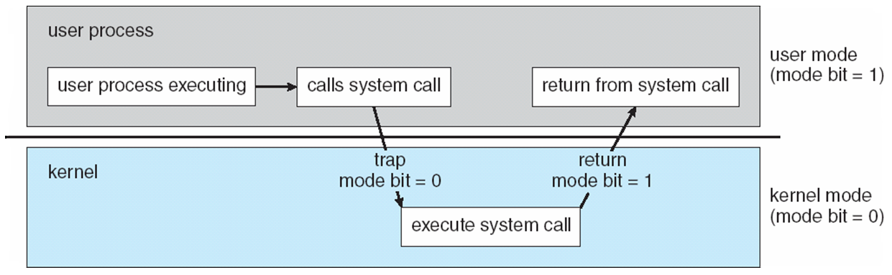
Transition from User to Kernel Mode

Slide 6
What happens on a hardware interrupt?
6
1
4
7
5
9
2
3
8

Slide 7
System Calls
Programming interface to the services provided by the OS
Typically written in a high-level language (C or C++)
Mostly accessed by programs via a high-level Application Programming Interface (API) rather than direct system call use
Three most common APIs are Win32 API for Windows, POSIX API for POSIX-based systems (including virtually all versions of UNIX, Linux, and Mac OS X), and Java API for the Java virtual machine (JVM)

Slide 8
System Call Implementation
Typically, a number associated with each system call
System-call interface maintains a table indexed according to these numbers
The system call interface invokes the intended system call in OS kernel and returns status of the system call and any return values
The caller need know nothing about how the system call is implemented

Slide 9
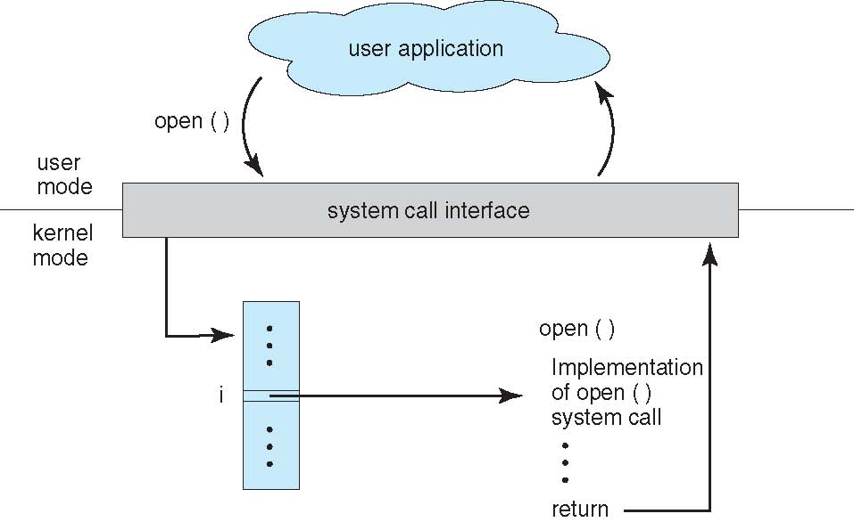
API – System Call – OS Relationship

Slide 10
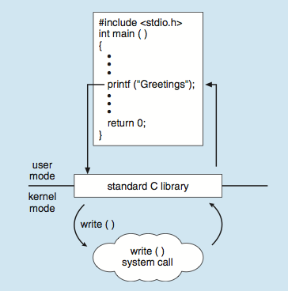
Standard C Library Example
C program invoking printf() library call, which calls write() system call

Slide 11
What happens on a syscall?
2
7
6
12
10
1
3
5
4
11
8
9

Slide 12
System Call Parameter Passing
Three general methods used to pass parameters to the OS
Simplest: pass the parameters in registers
In some cases, may be more parameters than registers
Parameters stored in a block, or table, in memory, and address of block passed as a parameter in a register
This approach taken by Linux and Solaris
Parameters placed, or pushed, onto the stack by the program and popped off the stack by the operating system
Block and stack methods do not limit the number or length of parameters being passed

Slide 13
How to add a system call to an OS?

Slide 14
Xv6 Code Walkthrough
IDT table initialization
Syscall table
How a syscall is invoked
Syscall implementation
Parameter passing into a syscall
In Lab 1 you will add a system call to Xv6

Slide 15
Operating System Structure
General-purpose OS is very large program
Various ways to structure an OS:
Simple structure – MS-DOS
More complex – UNIX
Layered – an abstraction
Microkernel – Mach

Slide 16
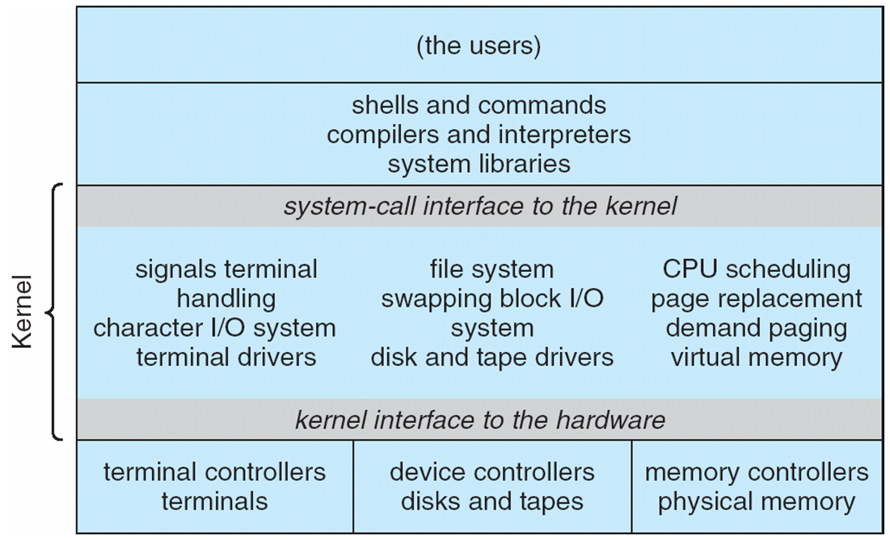
Traditional UNIX System Structure
Beyond simple but not fully layered

Slide 17
Microkernel System Structure

Slide 18
Process Concept
An operating system executes a variety of programs:
Batch system – jobs
Time-shared systems – user programs or tasks
Process – a program in execution; process execution must progress in sequential fashion
Multiple parts
The program code, also called text section
Current activity including program counter, processor registers
Stack containing temporary data
Function parameters, return addresses, local variables
Data section containing global variables
Heap containing memory dynamically allocated during run time

Slide 19
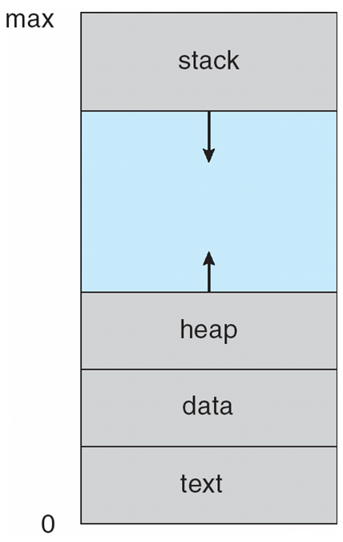
Process in Memory

Slide 20
Process State
As a process executes, it changes state
new: The process is being created
running: Instructions are being executed
waiting: The process is waiting for some event to occur
ready: The process is waiting to be assigned to a processor
terminated: The process has finished execution

Slide 21
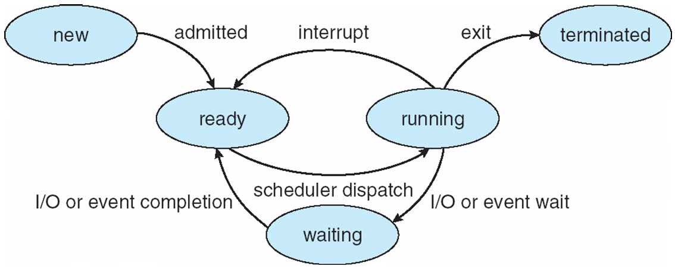
Diagram of Process State

Slide 22
Process Control Block
``Active entities are data structures when viewed from a lower level.’’
Raphael Finkel, University of Kentucky

Slide 23
Process Control Block (PCB)
Information associated with each process
(also called task control block)
Process state – running, waiting, etc
Program counter – location of instruction to execute next
CPU registers – contents of all process-centric registers
CPU scheduling information- priorities, scheduling queue pointers
Memory-management information – memory allocated to the process
Accounting information – CPU used, clock time elapsed since start, time limits
I/O status information – I/O devices allocated to process, list of open files

Slide 24
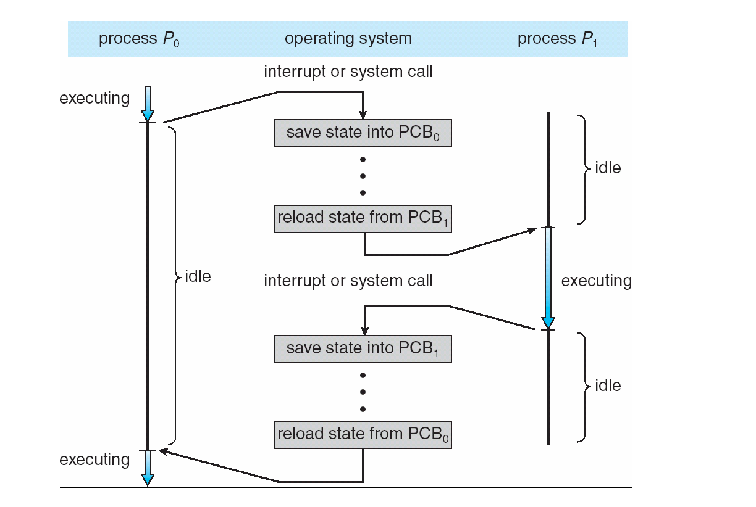
Context Switching

Slide 25
Context Switch
When CPU switches to another process, the system must save the state of the old process and load the saved state for the new process via a context switch
Context of a process represented in the PCB
Context-switch time is overhead; the system does no useful work while switching
The more complex the OS and the PCB ➔ the longer the context switch
Time dependent on hardware support
Some hardware provides multiple sets of registers per CPU ➔ multiple contexts loaded at once

Slide 26
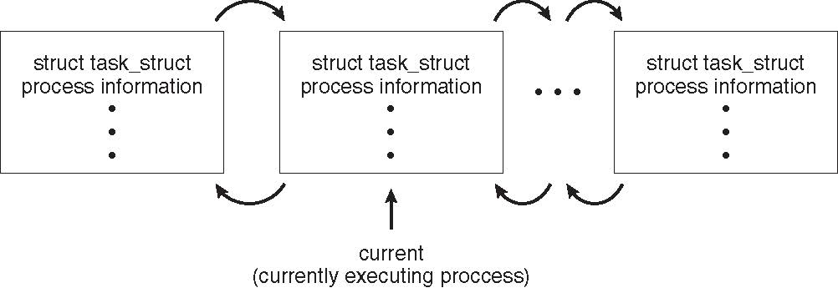
Process Representation in Linux
Represented by the C structure task_struct
pid t_pid; /* process identifier */ long state; /* state of the process */ unsigned int time_slice /* scheduling information */ struct task_struct *parent; /* this process’s parent */ struct list_head children; /* this process’s children */ struct files_struct *files; /* list of open files */ struct mm_struct *mm; /* address space of this process */

Slide 27
Xv6 Code Walkthrough
PCB and process table
context switching

